Slide 1
MACHINE LEARNING ASSIGNMENT
Praveen P
D18027

Slide 2
OBJECTIVE:
Evaluating the model complexity.
Data Set used : Cars.csv data
Github repository : https://bit.ly/2QytsPP

Slide 3
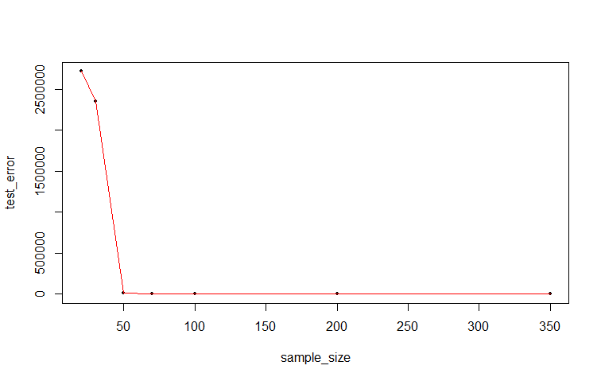
Sample size Vs Test Error ----------------------------------
Sample size of 10, 20, 30, 50, 70, 100, 200, 300 are taken from the train data and then each model is fitted with a linear regression model of order of 7.

Slide 4
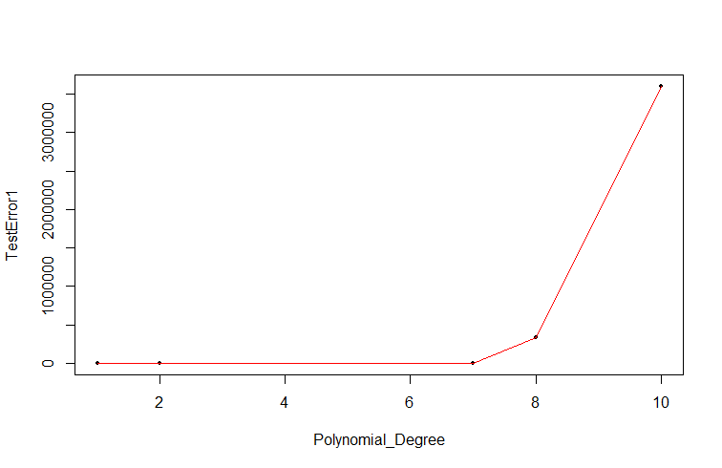
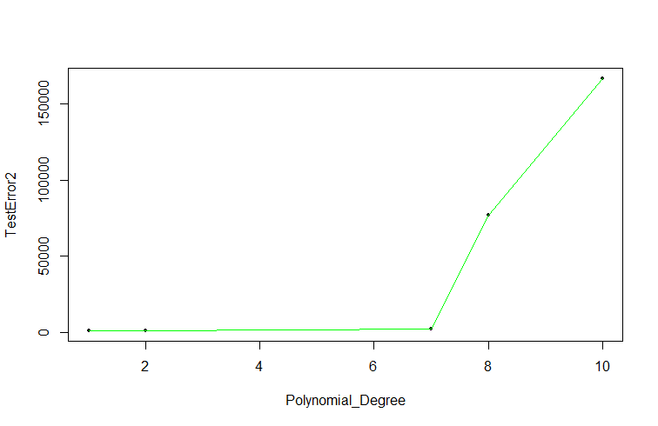
Polynomial Degree Vs Test Error -------------------------------------------
n = 20
n = 20
Take 4 sets of sample(n=20) from train without replacement and fit regression of order 1, 2, 7, 8, 9, 10 for each sample. Order of the polynomial Vs Test Error is plotted for each

Slide 5
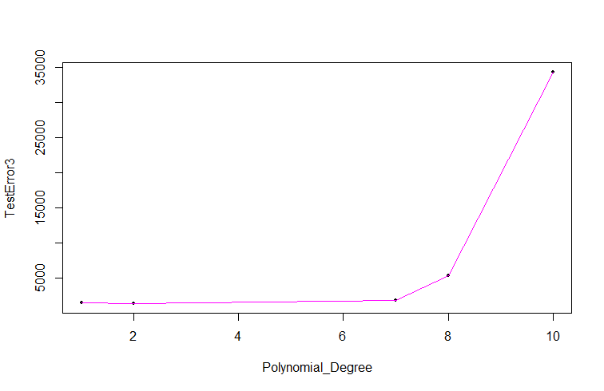
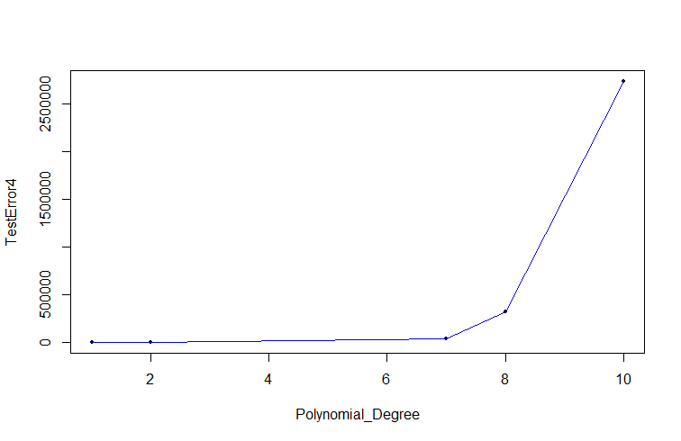
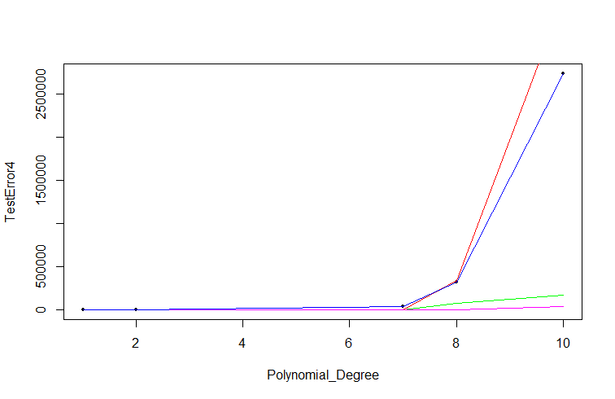
n = 20
n = 20
Combine all the four in a single plot for n = 20

Slide 6
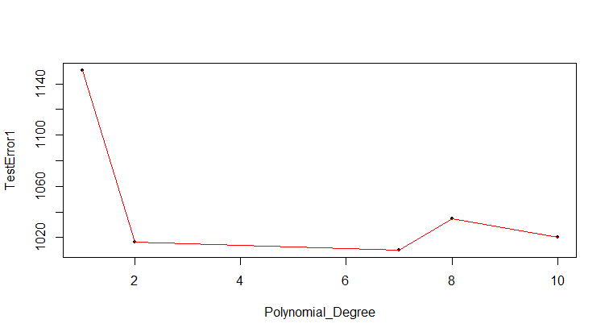
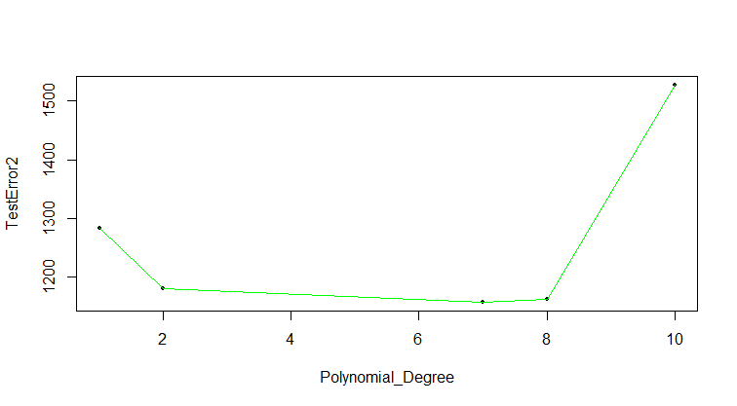
For n = 100
Take 4 sets of sample(n=100) from train without replacement and fit regression of order 1, 2, 7, 8, 9, 10 for each sample. Order of the polynomial Vs Test Error is plotted for each

Slide 7
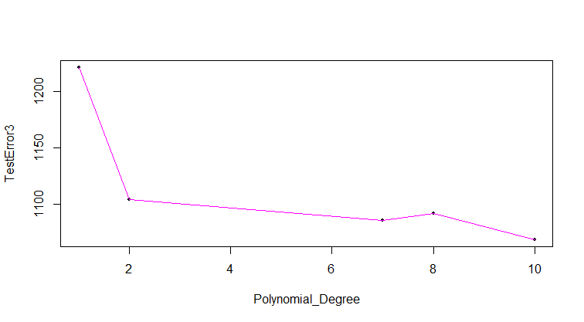
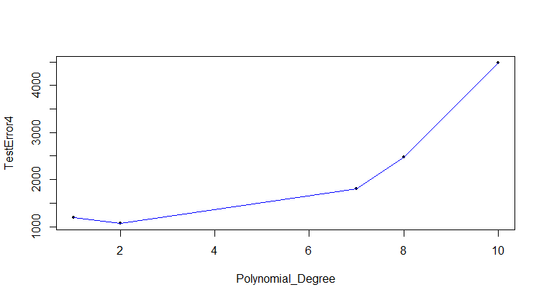
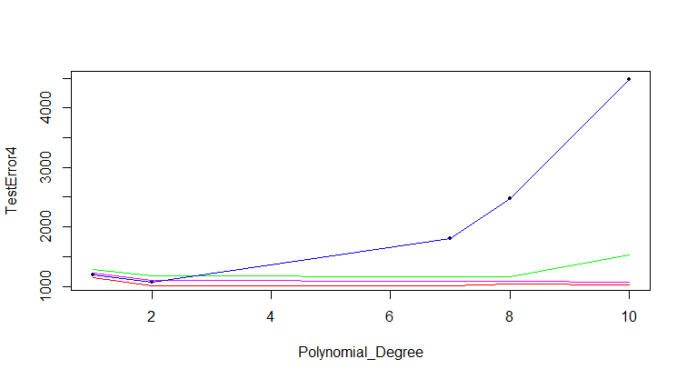
n = 100
Combine all the four in a single plot for n = 100

Slide 8
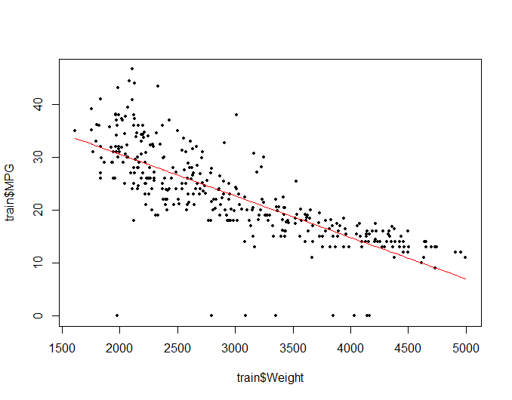
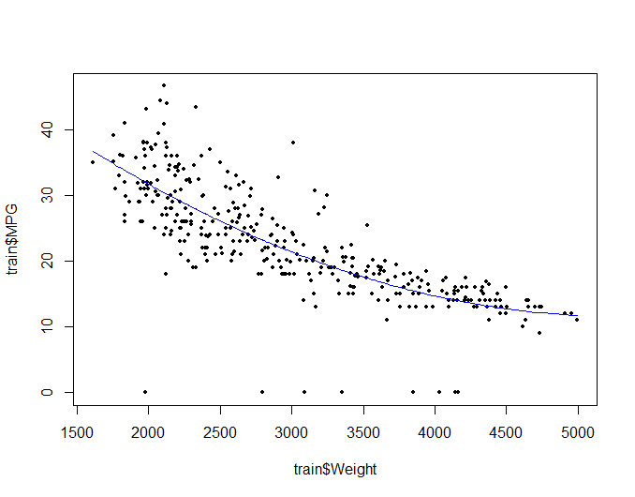
Regression line plot for different orders [train : 350, test : 50 obs] ---------------------------------------------------------------------------------------------
Order : 1
Order : 2

Slide 9
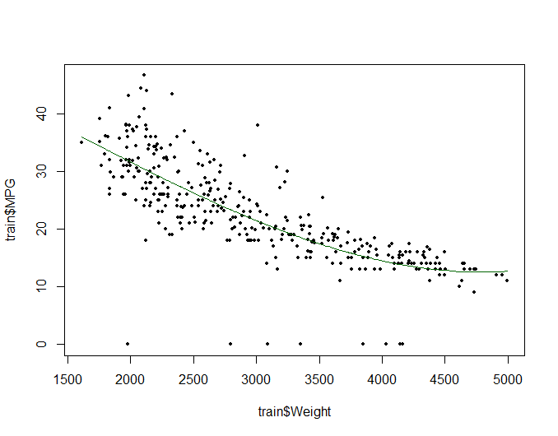
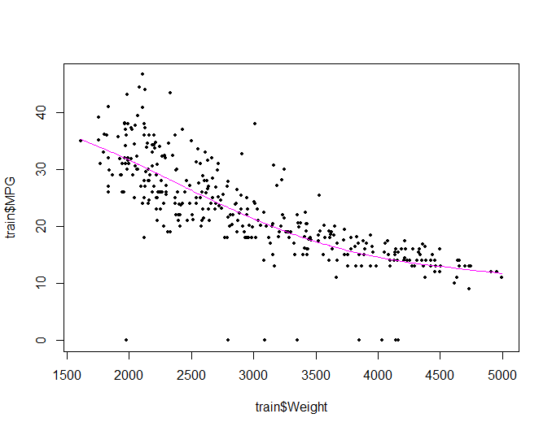
Order : 3
Order : 4

Slide 10
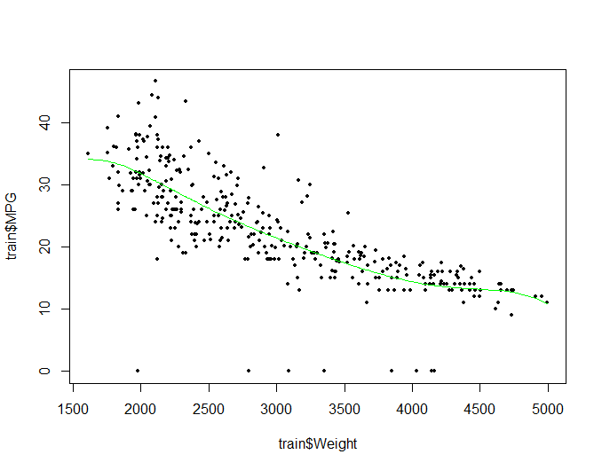
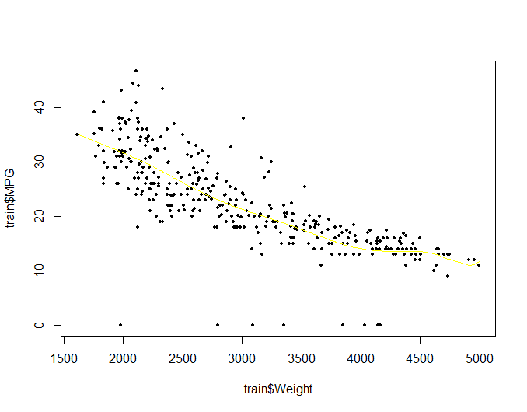
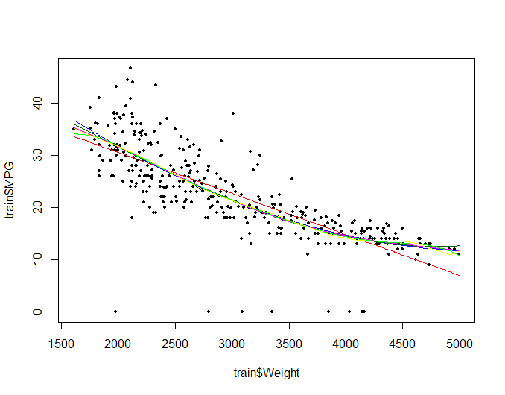
Order : 6
Order : 9
<- ---- All six combined

Slide 11
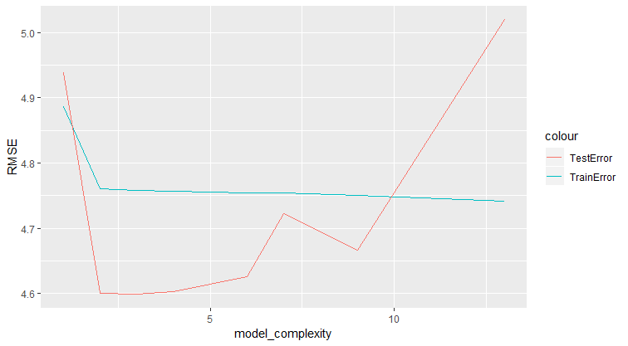
Model Complexity Vs RSS --------------------------------------
Train data : 350
Test data : 56
As the model complexity increases, train error decreases . While test error, at first decreases and then increases.

